Slide 1
SNDAN: Easily extensible Unix software package for spectral analysis, display, modification, and synthesis of musical sounds
James W. Beauchamp
School of Music
Dept. of Electrical and Computer Engineering
University of Illinois at Urbana-Champaign
jwbeauch@illinois.edu
http://ems.music.uiuc.edu/beaucham/

Slide 2
Talk Topics
SNDAN features
  time-domain utilities
  phase vocoder harmonic spectrum analysis
  spectral graphics, modification, resynthesis
  frequency tracking analysis, graphics, synthesis
  pitch detection, conversion to harmonic format
SNDAN applications
Future developments
Conclusions

Slide 3
SNDAN OVERVIEW:
signal
ANALYSIS FRONT END
analysis data
GRAPHICS
MODIFICATION
RESYNTHESIS

Slide 4
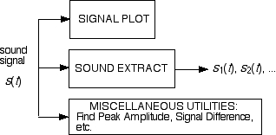
SNDAN OVERVIEW:
SIGNAL VIEWING AND EDITING

Slide 5
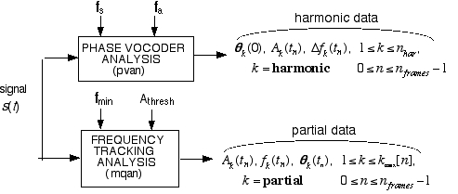
SNDAN OVERVIEW:
SPECTRUM ANALYSIS

Slide 6
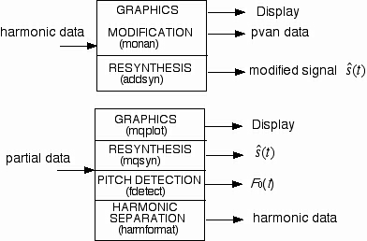
SNDAN OVERVIEW:
SPECTRUM VIEWING, MODIFICATION, AND
RESYNTHESIS

Slide 7
Phase Vocoder Analysis
f_{s} (sample
frequency)
f_{a} (analysis
frequency)
s(t)
BANDLIMITED
INTERPOLATION
RESAMPLER
s’(t)
HAMMING
WINDOW
(double period)
w(t)s’(t)
sound
signal
OVERLAP BY
1/2 PERIOD
THROW AWAY
K/2, K ODD
COMPUTE
AMPLITUDES
AND PHASES
DISCRETE
FOURIER
TRANSFORM
(FFT)
COMPUTE
FREQUENCY
DEVIATIONS
harmonic data

Slide 8
Harmonic Data Graphics
1D: Amplitude vs. Frequency
(snapshot bar, line; comp. overlay)
1D & 2D: Frequency vs. Time
(individual, spectrogram)
3D: Amplitude vs. Frequency
and Time
Inharmonicity vs. Time
Spectral Centroid vs. Time
Spectral Centroid vs. RMS Ampl.
Spectral Irreg. vs. Time
Inverse Spectral Density vs. Time
Musical Pitch vs. Time
harmonic data
EPS graphics
display

Slide 9
Example 2D spectrum graph: trumpet F₄ (350 Hz)

Slide 10
Example 3D spectrum graph: trumpet F₄ (350 Hz)

Slide 11
Harmonic Data Modification
Smooth A_{k} vs. time (t)
Make A_{k}(t) proportional to A_{rms}(t)
Smooth A_{k} vs. frequency (k)
Scale A_{k} by k^{p} to achieve new
average centroid
Scale A_{k} to achieve designated
spectrum or aux. spectrum
harmonic data
harmonic data
Smooth f_{k} vs. time (t)
Make all f_{k}(t) harmonic to f_{ave}(t)
Flatten f_{k} to average or harmonic
Quantize fund. freq. to ET pitch
aux. harmonic data
Warp attack time
Reduce duration without
affecting attack and decay.

Slide 12
Harmonic Data Resynthesis
AMPLITUDE & FREQUENCY
LINEAR INTERPOLATION
synthetic
signal
harmonic data
(scale amplitude, freq, duration)
AMPLITUDE & PHASE
QUADRATIC INTERPOLATION

Slide 13

Signal Modification Example
Original
Flute (E^{b}₄)
Time-smoothed
Amplitudes
Time-smoothed
Amplitudes
& Frequencies
Time-smoothed,
RMSed, &
Spectrum Envelope
Smoothed &
Flattened Frequencies
Time-smoothed
Amplitudes
& Flattened
Frequencies
Time-smoothed,
Spectrum Envelope
Smoothed &
Flattened Frequencies

Slide 14
Frequency-Tracking (MQ) Data Analysis
f
_{s}
f_{min}
A_{thresh}
s(t)
KAISER WINDOW
WITH 100% ZERO
FILL
FFT WITH
TYPICAL 6 MS
HOP
sound
signal
AT EACH FRAME
COMPUTE EACH PEAK’S
AMPLITUDE, FREQUENCY
AND PHASE
APPLY THRESHOLD
IDENTIFY AND SAVE
SPECTRAL PEAKS
CONNECT PEAKS
TO NEXT FRAME’S
PEAKS (TRACKS)
partial (MQ) data

Slide 15
MQ Partial Data Processing
Graphics
partial data
2D: FREQUENCY VS. TIME
3D: AMPLITUDE VS.
FREQUENCY VS. TIME
EPS display
time
scale
Synthesis
synthetic
signal
partial data
INTERPOLATION:
AMPLITUDE - LINEAR
PHASE - CUBIC

Slide 16
Partial Data Processing
Pitch Detection
f_{min}
f_{max}
fundamental
frequency
data
F₀(t)
partial data
TWO-WAY MISMATCH
HARMONIC MATCHING
METHOD
Harmonic Separation
n_{har} (no. of
harmonics)
frequency
tolerance
partial data
HARMONIC
SIEVE
harmonic data
fund freq data
F₀(t)

Slide 17
Saxophone Solo
2D Peak Track Plot:
Pitch Plot:
Original Sound
Synthesized from
MQ Data
Synthesized from
Harmonic-sieved
Data
MQ Data
Stretched x2
Harmonic Data
Stretched x2
Harmonic Data
Stretched x2
Smoothed Freq

Slide 18
Applications
Synthesis instrument development
  nonlinear and frequency modulation
  wavetable trumpet and piano
Timbre investigations
  simplified sounds for discrimination studies
  normalized sounds for MDS studies
  perturbed sounds for discrimination studies
  synthesis quality evaluation
Music composition using Music 4C

Slide 19
Future Developments
More features for partial data format
Integrate programs into single program
More advanced analysis front end
Multi-Channel
Create GUI interface
Real time
Port to more platforms

Slide 20
SNDAN Conclusions
Provides analysis, graphics, modification, and synthesis
Specialized for musical sounds
Two spectrum data formats: harmonic and MQ partial
Contains pitch detector
Unix source code (in C) modular and easily extensible
Source & binary code available at:
  http://ems.music.uiuc.edu/beaucham/software/sndan/
DOS binary version available at:
  http://ftp.cs.bath.ac.uk/pub/dream/SNDAN32/
GUI spinoff analyzer available at:
  http://www.klingbeil.com/spear/

